Slide 1
Optimistic Programing
Dan Nahari
Phone: +972-54-599-4706
Email: naharydan@gmail.com
Based on:
Boom Performance
By Eran Zinman

Slide 2
Let’s put it in numbers:
10,000ms
Doesn’t work?
1000ms
Likely mental context switch
300-1000ms
Machine is working
100-300ms
Small perceptible delay
0-100ms
Notes:
10,000 – filling something is stack and not working
1,000 – starting to think on something else… instead to stay at application context their mind starting to be in somewhere else
300-1,000 – The user is filling that something is working, there is a response from the server
100-300 – This delay is acceptable. The user can receive it and not thinking on something else
0-100 – The user fill it’s instant.

Slide 3
Let’s put it in numbers:
10,000ms
Doesn’t work?
1000ms
Likely mental context switch
300-1000ms
Machine is working
100-300ms
Small perceptible delay
0-100ms
Notes:
10,000 – filling something is stack and not working
1,000 – starting to think on something else… instead to stay at application context their mind starting to be in somewhere else
300-1,000 – The user is filling that something is working, there is a response from the server
100-300 – This delay is acceptable. The user can receive it and not thinking on something else
0-100 – The user fill it’s instant.

Slide 4
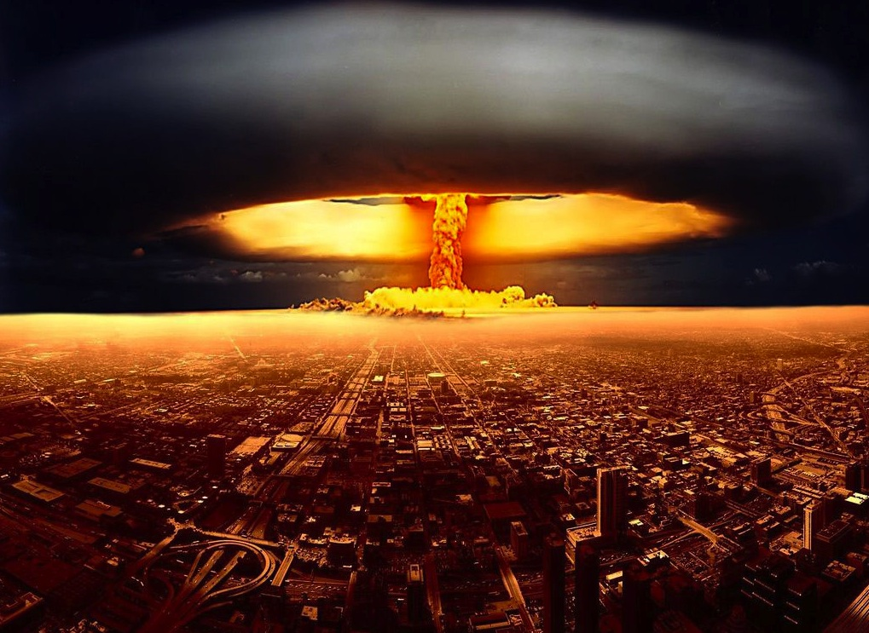
INSTANT
Notes:
1) We Want to achieve this speed, Instant.

Slide 5
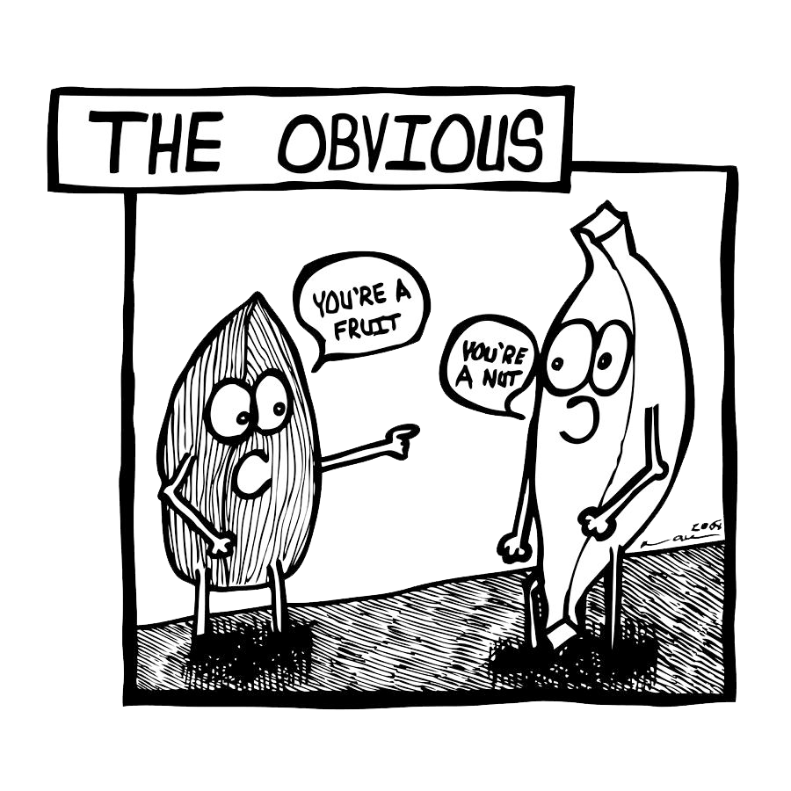
Notes:
Performance it is obvious, we know it’s important, well sometimes the impertinence isn’t clear or intuitive to the developers
Speed affects your product and the happiness of your users.
You don’t know when your users suffering from your product, but as a users you know only when you are suffering from other products.
The question is how we will take it to next level
Let see example

Slide 6
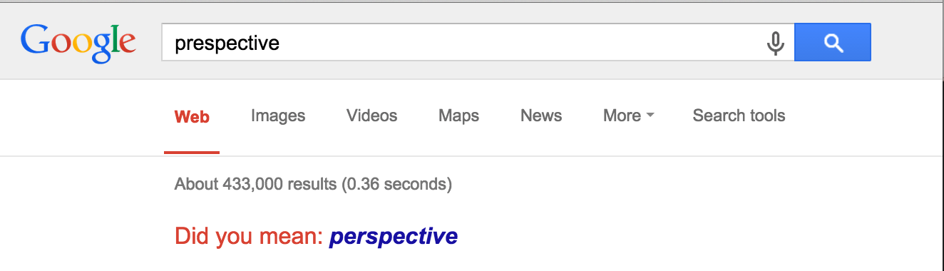
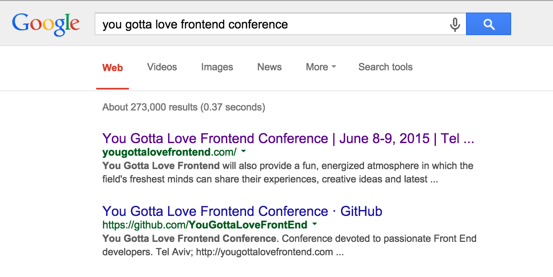
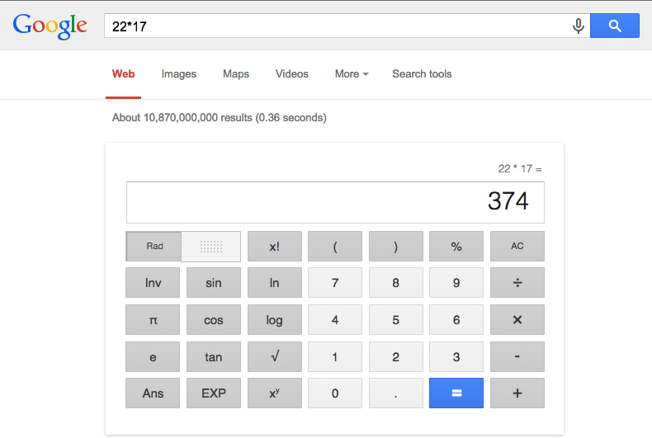
Instant Speed = More Usage
Notes:
When you think on google you think on something fast.
If we looks at google search it’s very simple, just input and that it.
But it’s so fast so we don’t use it only for search, instead going to dedicate website/application we are using google also for:
Incorrect spelling
Math operations
Unit conversions
Money and unit conversions
Places nearby
Current whether
https://www.lifehack.org/articles/technology/20-tips-use-google-search-efficiently.html

Slide 7

Notes:
Instant Speed = Simpler UI
Customer will not ask “Can you add the edit button on the main project list page? It will be faster to edit projects this way”
When your UI is slow users will ask you for features that will make your UI more condensed.

Slide 8
Instant Speed = Addiction
Instant
I use it for everything
Fast Enough
I use it because it solves a pain
Not Fast Enough
Damn them for making me use this shi#$%#
Notes:
Invest in speed It’s one of the best things to spend your time on. Because great feature will effect / serve 10% of users but high performance will effect/serve 100% and will give high value

Slide 9

Notes:
Why speed is something developers/Scrum memebers should be in charge of (and not product/marketing)?
Because only developers/Scrum memebers understand the architecture of the system/product and know when/where we can improve it

Slide 10

Notes:
Let’s Start to solve issues
How to increase performance

Slide 11
Initial App Loading

Slide 12
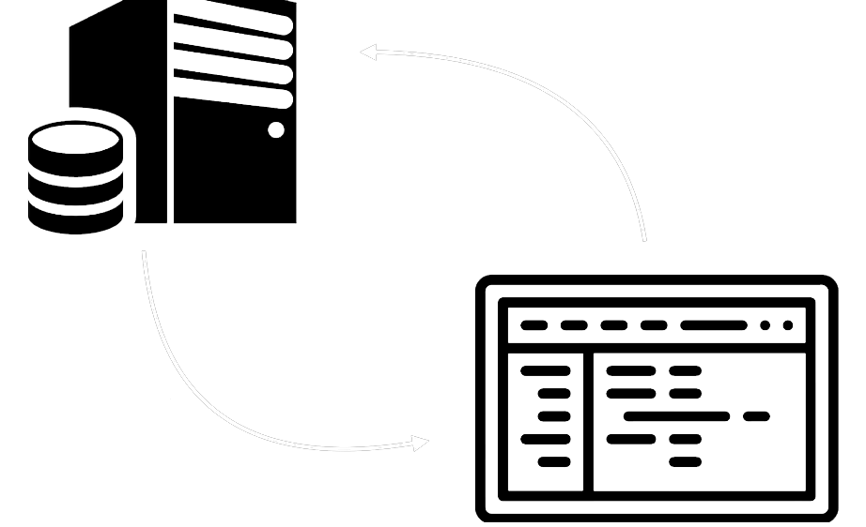
SSR (Server Side Rendering)
http request
static HTML
Notes:
Not new, we are familiar with it in PHP, ASP, JSP….
Client sending http request -> Server returning static html.
Pros:
Getting initial view very fast because we are getting static html (With server-side rendering, your server's response to the browser is the HTML of your page that is ready to be rendered so the browser can start rendering without having to wait for all the JavaScript to be downloaded and executed. There's no "white page" while the browser downloads and executes the JavaScript and other assets needed to render the page)
Search engines can crawl the site for better SEO.
Site preview – when we are sharing a link on social medial, if the application not rendering on server side we will not get a site preview
Great for static sites.
Cons:
Next request will be heavy
Full page reloads.
Frequent server requests.
Non-rich site interactions.

Slide 13
SPA (Single Page Application)
http request
javaScript
assets
html
data
Notes:
Client send http request -> Server will return all the assets, all JS, all html, all the things we needs.
From this point the client will send request and receive only data
Pros:
After initial view the application become very fast because we need to get only data (Fast website rendering after the initial load).
Rich site interactions
Great for web applications.
Robust selection of JavaScript libraries.
Cons:
Getting initial view is slow because we need to get all the assets, JS, html etc. and then we can see our initial view.
Low SEO if not implemented correctly.
In most cases, requires an external library.

Slide 14
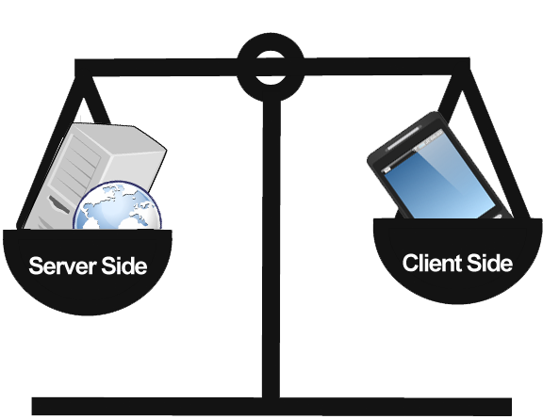
Notes:
So, Server side is good and also Client side is good.
There is a way to combined them?

Slide 15
Rendering Strategies

Slide 16
Shell
Notes:
We are getting from the server static shell (static html)
And then we are waiting for the client to render the content (we are getting initial view without any data inside, we can see the shell but it’s blank until the content is coming)
Usually we can see it in mobile application like Facebook, Linkedin etc.

Slide 17
Hydrate
Notes:
This is how server side React works.
First request we are getting initial page (static html)
Then in the background we are downloading all the JS we need
Then when the client side is bootstrapping it connected to server view (hydrate it, attach events, make it interactive and provide a fast first paint on first load).

Slide 18
Re-Render
Notes:
Basically, same like Hydrate but…
First we are getting static view from the server
Then we download all the assets, JS, images, etc. we need.
Once external resources loaded, Angular client bootstrapping begins
After bootstrap completed, we switch the views (basically we rendering the page twice, first when we hit the server and second when the client is ready)
This is how Angular Universal is working
https://universal.angular.io/overview/

Slide 19
Shell Architecture in Facebook
Notes:
Shell Architecture in Facebook
No lodging indicator
Filling faster

Slide 20
Facebook with Indicator
Notes:
If Facebook had loading indicator

Slide 21


Slide 22

Notes:
Handling a lot of data:
First we fetch all data but it will be to much/heavy
We decide to use lazy loading
We manage lazy loading with getting next block before demanding it
After 500~1000 records DOM was to heavy
We use virtual scroll

Slide 23
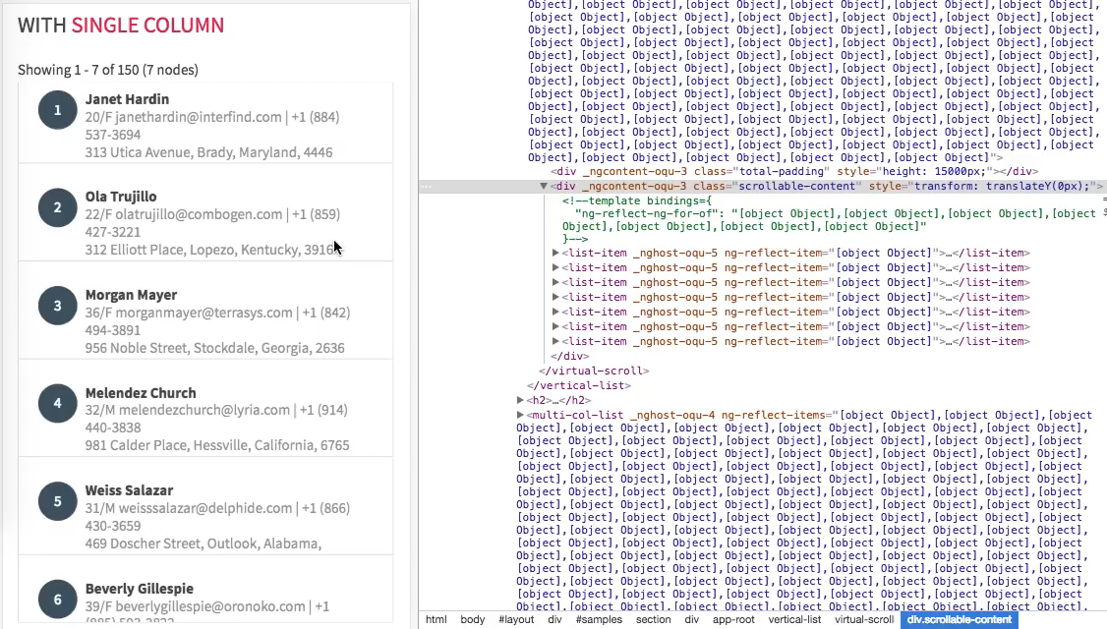
Notes:
Virtual scroll demo

Slide 24
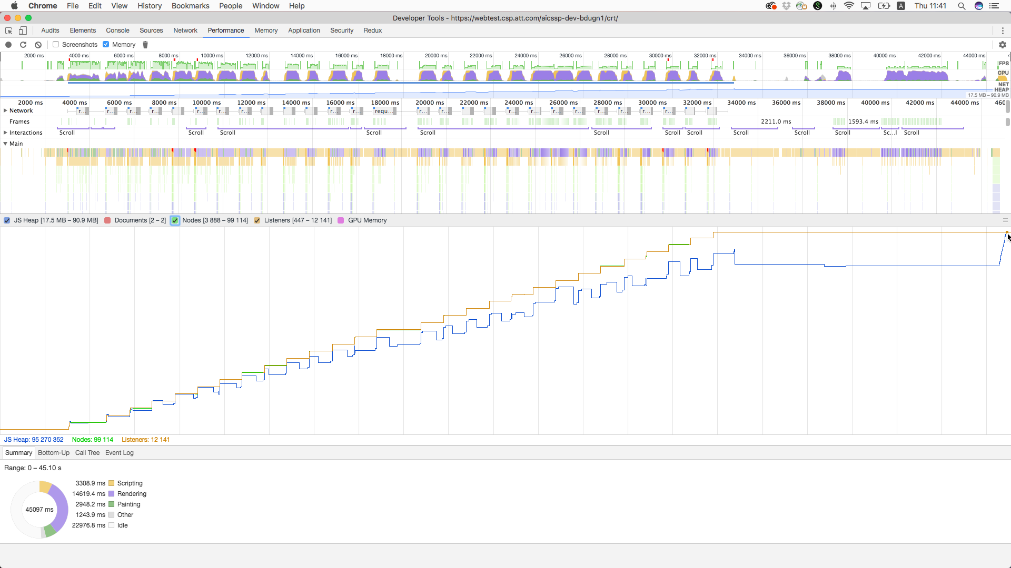

Slide 25
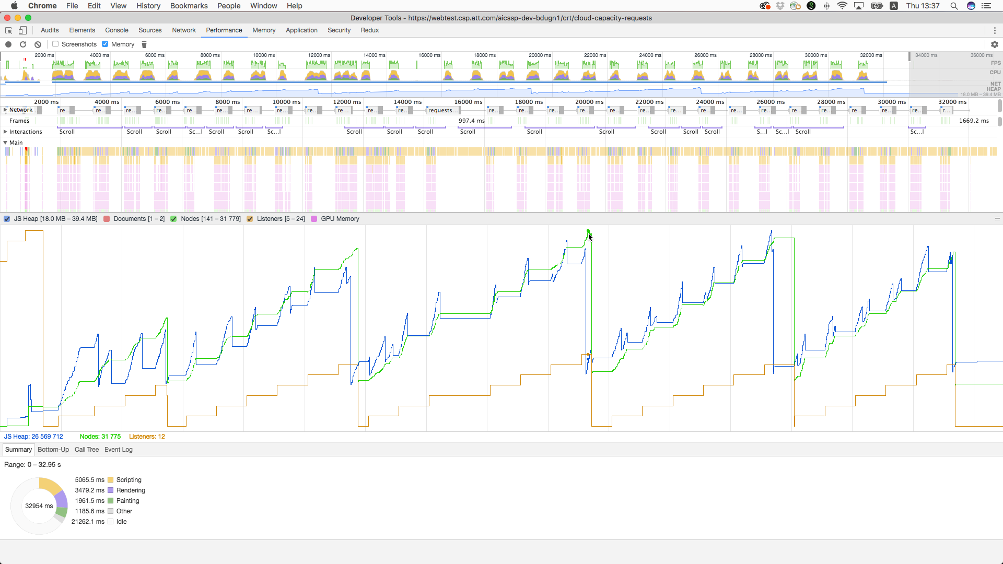

Slide 26
Habdson – cat virtual scroll
Notes:
Use CDK for virtual scroll
Show them steps to add it
Do messurment before and after

Slide 28
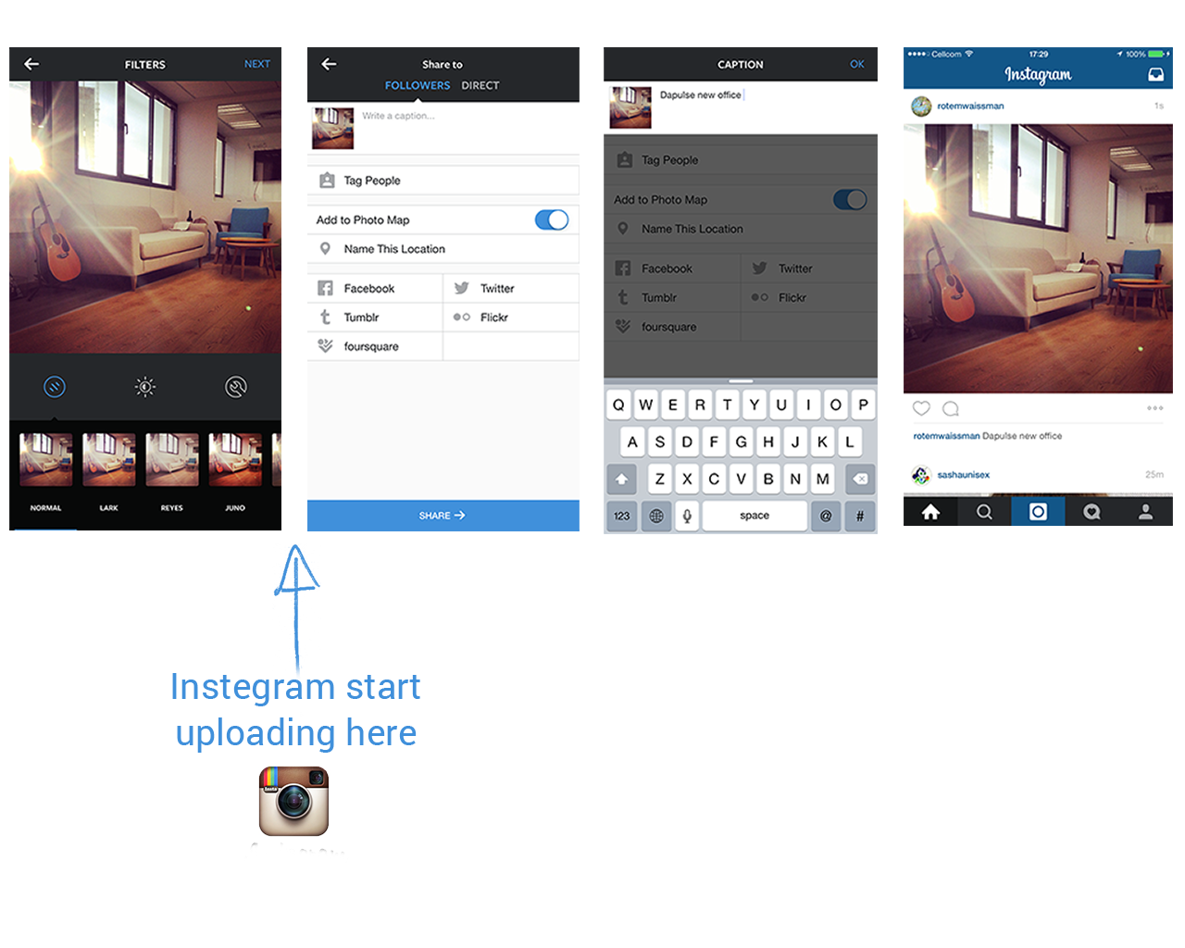
Instagram Example
Instagram starts uploading here
Most apps start uploading here
Notes:
Instegram process
Picturing picture
Choosing we to share it
Adding description (metadata)
Clicking share
Picture and description added
Most app will upload the photo on submit but Instegram started to upload when we choose the photo and until the user finish to insert his metadata the picture was already in the server

Slide 29
Facebook Example
Notes:
Facebook did a lot of crazy stuff related to performance.
Every things is working very fast.

Slide 30
Facebook Example - optimistic
Notes:
Client changed be we are receiving response (first we will take care of the UI and then we will check if everything is ok).

Slide 31
WhatApp Example
Notes:
WhatApp is dong something similar,
When user is sending a message they are rendering it as send and adding a small indicator what of the status of this message:
Clock - it’s processing
One V – it was sent
Two V – the target receive it
Blue two V – the target read the message
This give the user amazing experience
What will happened if no internet
Clock will be shown and it’s processing for ever until we will have internet connection
The also improve video sharing like youtube is doing.
When we are downloading a video we don’t need to wait for full download we can star and watch the present we already downloaded

Slide 32
Predict
Notes:
Most of the time we can predict our user behavior.
The users will do the same search and the same selection,
This behavior give us the ability to predict his selection.
How we will predict user selection?
Track what your users are searching or selecting.
Preload that into the client.
Assume “history will repeat itself” and render it BOOM fast in the UI.
Achieve user happiness :)
There are some libraries which help us to achieve this behavior, one of them is typeahead
We can see over here a combination of data receiving from client and server,
So if user usually have 5 friend he is tagging and we will show him them first and then we will complete the search from the server then he will receive amazing UX because most of the time he will choose one of this 5 friends
Client side libraries
Typeahead.js – Strong client side search / autocomplete.
Lunr.js – Powerful client-side Solr / ElasticSearch alternative.
Local Storage is your friend:
Draft saving
Result caching

Slide 33
Credit: http://blog.teamtreehouse.com/perceived-performance
Notes:
Sometimes adding animation instead of loader/spinner will looks faster

Slide 35
Don’t wait for success. Operate
// Make AJAX request to create post for user
$.ajax("/user/post", {
type: "POST”,
data: { from_date: this.from_date },
dataType: "json”,
success: function(data) {
},
error: function(data) {
// Notify the user on error
...
...
}
});
// Render new post in the UI
... ... ...
... ...
Notes:
Take what you have in the success to outside
Think positive:
If you know the expected result in the client (adding a user to a list, writing a reply, liking a comment, deleting an object, etc…): Assume it worked and render it BOOM fast in the UI.
Most of the time, if it fails, don’t do anything (or rollback to previous state).

Slide 36
Order flow
Notes:
Let see a regular order flow
We will add a product to our cart and start checkout
We will choose our address
We will review our order
Will choose payment method
And make a payment
What is the issue with this flow?
Any ideas?
Processing time is taking to much time, we are waiting for vendor to complete the transition and then showing confirmation page, but this is taking to much time.
How can we increase user experience?
Easley, we don’t need to wait for success, we can operate it (I think this is also what Amazon is doing).
We will do a handshake with our server and show confirmation page to the user.
Flow:
Post request to our server for payment with order id
Server receive the request and return 200 to the frontend
FE receive 200 and show confirmation page to the client with a message telling “Thank you. We're processing your order and will send you an email confirmation shortly.”
Server is processing the order in the background, when transaction is done we will send confirmation email to the user, incase of error we will send the user email informing the order didn’t complete and he need to check the order or contact support center
Let see how it will looks like in video

Slide 37
daPulse Signup Example
Notes:
daPulse is project management tool, they change there name and now it’s monday.com
They have a signup flow with 3 pages instead of 1 page which contains all there fields.
Why? It won’t be better for UX to have just 1 page?
Well we need to understand what they did & why they did.
Let see the flow:
Populate company name and the amount of employees
Populate sub domain
Populate you name and more info
In step 1 & 3 we don’t have any issues, we can just operate and then make the request to the server,
But in step 2 we have issue because if the sub domain is already exist then we can’t go to step 3 in our flow so we must to verify it in the server and wait for the response
This step can be frustrating because the user can enter sub domain and click next and wait just to receive this sub domain is taken, and it could happened more then one time.
So what they did?
For each character the user enter they made a request to the server to check if it’s available before the user click on next, so when the user will focus out from the input 2 cases can happened
If it’s ok and the sub domain is available then when the user will click next button we will navigate him to next step
If sub domain is not available we will show him a message even if he didn’t click on next button
With this behavior the user didn’t know this action is bothering us and we give him instant behavior
This increase users finishing signup flow in 8%.
Of curse we are making a lot of requests to the server but the user experience is increased
https://monday.com/monday-project-management-renaming/

Slide 38
turn.js
Notes:
Turn Js is a library that will make your content look like a real book.
Let’s take a look how it’s working:
We can see we have a book, and clicking on the corner it will flip like a real page flip.
According to the index we have at least 97 pages but we are not rendering all of them.
But how it’s looks like in the DOM?
We can see we are rendering only 6 pages. 2 current pages, 2 previews pages and 2 next pages.
In this way we always have the next block ready and when we are flipping the page we can see the next one behind the scene.

Slide 39
The fastest request is “no request”
Notes:
If we can:
operate what we have in success function
predict what user will do
prefetch (or doing in background) the data
Then, we will give the user amazing experience.

Slide 40
Hands-On for like/remove
Notes:
For each request set timeout 3s but we will process it without waiting for respond
One cat will have error, they will need to handle it.

Slide 42
Ifarme
Notes:
What is Iframe?
First , it’s html tag,
An IFrame (Inline Frame) is an HTML document embedded inside another HTML document on a website. The IFrame HTML element is often used to insert content from another source, such as an advertisement, into a Web page.
In other words, another website inside our website.

Slide 43
Iframe Examples
Notes:
What we need is to put the URL and that it’s.
There are 2 kinds if URLs, URL from same origin and URL from other origin (cross origin).
Is there is a different between them with how iframe behave?
Yes, mostly with communication

Slide 44
Iframe Communication
Notes:
How can parent communicate with his child iframe?
Well, if they are from same origin then just buy selecting the iframe and accessing contentDocument and we can do any manipulation we want.
But Iframe from other origin we can’t access and do manipulation and this is because security issues that can happened.
Does child iframe can access his parent?
Yes, if we are on the same origin the child can do it by `window.parent` and do what he wants.

Slide 45
Vendor payment example
Notes:
Who order something from ebay?
How did you pay?
With PayPal usually,
Do you remember the flow?
You are selecting a product & adding to cart-> starting checkout flow -> on payment step we are redirect to PayPal page! (we are not in ebay anymore) -> we are login and paying the order amount -> on transaction complete we are redirect to ebay success page.
What is the issue with this process? We are going out from our website and then coming back to.
Why is that an issue?
First we are loading and initializing/bootstrapping our web site twice, on when the user arrived and second on PayPal redirect
Second, user is not in our site (ebay) so he loose the context, we want him to fill he is still in our site.
So, how can we solve it? Any ideas?
What usually applications will do they will give a fake return URL to the vendor so when the vendor will redirect to this URL (remember the vendor is inside iframe so it will change the iframe location) we will not show anything and only notify the parent that the order is complete,
How?
Via window.parent, remember, when we load PayPal inside our iframe it’s other origin so we can’t access it but when PayPal changed his location to our fake URL then the iframe is now on same origin so it have access to the parent and the parent have access to him.

Slide 46
Vendor payment example - basic
Notes:
Let see it in video.
******************EXPLAIN EACH PART WHAT WE SEE******************
We are adding a payment method
We are putting our personal information
We will make a pos request to our server with our return and cancel URL, our server will send it to the vendor and will receive a “token” for our transaction and will return to our client the URL with our token.
We will load our vendor inside iframe
We can see the vendor is inside iframe with the URL we receive from our server
We will put payment information and click “Complete Order”

Slide 47
Vendor payment example - old
Notes:
Let see it in video.
******************EXPLAIN EACH PART WHAT WE SEE******************
When we will finish we will have OK button which will redirect our iframe to return URL we provide to our server
We can see a lot of files been loaded
We put a breakpoint on the function which will close the modal, but how we call it? Using `window.parent` in other words iframe is invoking parent method
We can see, when we click on “OK” we made ~30 requests, we ask for 9MB resources and we download 1.5MB
Our Iframe will contain our application structure and not vendor structure

Slide 48
Vendor payment example - issue
Notes:
What is the issue with this behavior?
Again, we are loading our application twice one in our parent and one in our child-iframe.
So, we solve user loose context but not loading & initializing/bootstrapping our application twice.
Any idea how we can solve it and not loading & initializing/bootstrapping our application twice?

Slide 49
Vendor payment example - new
Notes:
Can we solve it? Any ideas?
Well this solution can be solve by server side or client side (client – return url to static html, server – return url to specific route and ngnix/server will catch it and will return in response the static html ),
We did it in client because it was faster.
So what is the solution?
We will not load our application, instead we will load light html file without nothing and only with one line script which notify the parent that order complete.
Let see it in video.
******************EXPLAIN EACH PART WHAT WE SEE******************
In the network payment-success.html is loaded
Our code stop on our complete order success
We can see it was invoked by `window.parent.messageDispatcher.dispatch('VENDOR_PAYMENT_SUCCESS’)` code
In our network we made only 1 request (the second is just analytic request) and only 776 bytes pass
In our iframe we can see we have html with just script data
In this way we increase our performance & user experience by reducing network request and not initializing our application twice

Slide 51
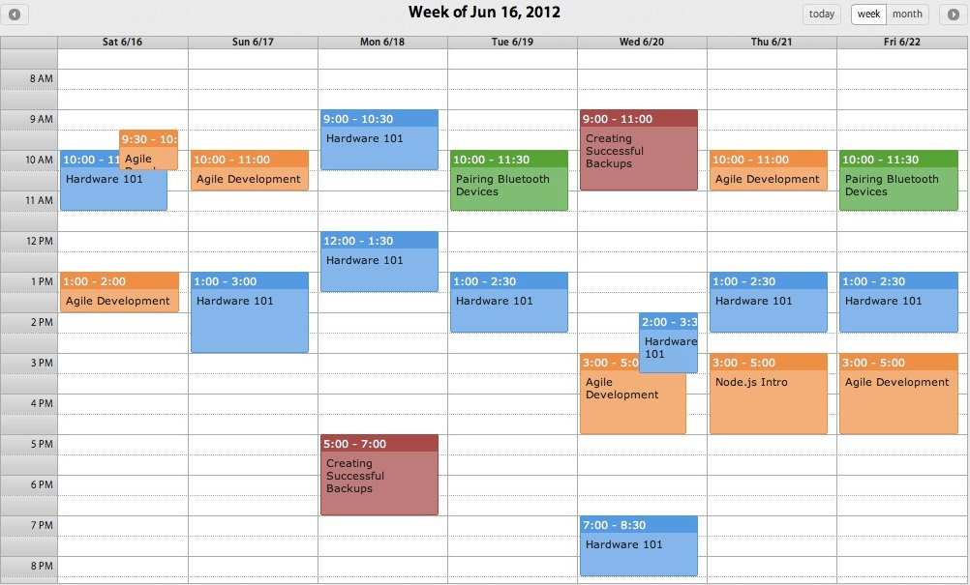
Notes:
Manage your Events
Events are very heavy so we need to handle them correctly
Example:
1) Let say we have event listener for dropdown that we are closing it if we are clicking anyware in the window.
Usually we are putting listener on the global window.
Now, imagine that you table with 40 dropdown that listening to the window…
Well it’s starting to be to heavy…
What we did, we create click outside directive that listening to window only if the dropdown is open, so from 40 events we decrease to 0,1 events (only one will be open at each time)
2) Virtual scroll, when we use it we also decrease that events listener because we have less elements at the DOM

Slide 52
Click outside
scope.clickOutsideApi.startListening = () => {
... ...
... ...
});
scope.clickOutsideApi.stopListening = () => {
... ...
... ...
}
Notes:
Click Outside Example:
DorpDown, on click outside of the drop down we want to close it so,
We will start l listening to the event only when dropdown is at open mode and at close mode we will stop listening

Slide 53
Don’t shoot yourself in the foot
for (var i=0; i < posts.length; i++) {
...
}
var x = $(“.post_wrapper > .reply”).data();
$('#item').css('color', '#123456');
$('#item').html('hello');
$('#item').css('background-color', '#ffffff');
// you could use this instead
$('#item').css('color', '#123456').html('hello').css('background', '#ffffff');
// or even
var $item = $('#item');
$item.css('color', '#123456');
$item.html('hello');
$item.css('background-color', '#ffffff');

Slide 54
Summarize
Notes:
It’s your responsibility for the performance.
Always think how you can assist and improve user experince
You need to think out of the box to create creative solutions
It will give you more benefits then making new amazing feature

